Slide 1


Master’s research project
Kick-off presentation

Slide 2
Outlines
Brief introduction
Project objective
Previous work review
Minimum requirements
Model suggestions
Components selection
Work plan
Timeline

Slide 3
Brief introduction
Personal information:
Master’s degree: Mechatronics
Research project credit points: 12
Expected project period: 360 h of independent study.
Area of expertise: Embedded software development, communication networks.
Area of interest: IoT, Networked Embedded systems, Cyber-Physical systems.
E.g., Smart cities, smart products, smart homes, smart energy management systems…etc.

Slide 4
Project objective
Design and implement of a suitable vehicle model, with all the required hardware capabilities, that serve as an experimental platform to test and evaluate different CACC strategies, and communication schemes.
Target: Evaluate the model at the end, with different test cases.

Slide 5
Previous work review
CACC strategies must have a reliable communication network with min. packet loss, to carry information about the lead vehicle to achieve stable platooning.
CACC strategies have different polices, their min. hardware requirement should be identified and taken into consideration.
CACC should use a deterministic MAC protocol, therefore, the focus shall be on TDMA protocol.

Slide 6
Minimum requirements:
To achieve string stability, the platoon model should at least have the following:
Acceptable beacon frequency “CAM messages intervals” of 10 Hz (100 ms).
Packet loss should be minimum (i.e., zero).
information age along the platoon should be considered.
Information about the leading vehicle, could be speed, or acceleration.
Each member in the platoon should maintain the following information with a refresh rate (i.e., controller frequency) between (20 – 100) Hz:
Spacing error according to the spacing chosen policy.
Vehicle speed and acceleration.
Suitable actuators characteristics (e.g., response time…etc).
Acceptable sensors accuracy
Communication to main station for data logging.

Slide 7
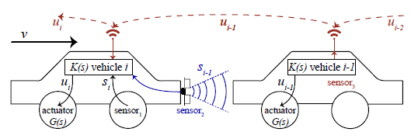
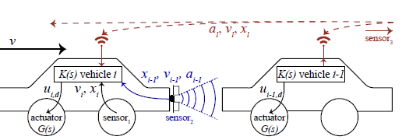
Model suggestions
Communication topology: (Either Lead vehicle broadcasting mechanism, or Information transmission a long the platoon)
Communication between vehicles and main station: Wi-Fi
Communication between vehicles:
The model shall have the capability to communication via (BLE, ZigBee, or Wi-Fi)
Communication topology: Mesh Communication
Communication scheme: TDMA is desirable, however, that will depend on different factors.
Vehicle2vehicle communication
Broadcasting communication
Reference: Daniel Plöger. Robust Communication For Control of Robotic Vehicle. July 2017

Slide 8
TDMA minimum requirements
Controllers synchronization algorithm.
Master-slave topology, master being the station controller (Infrastructure), slave being the 3 vehicles.
Transition rate.
Number of slots.
Define slots type.
Initialization algorithm.
Advanced: Dynamic TDMA.
Do you have any additional considerations?
Notes:
Currently, I am looking for the previous thesis, for the TDMA rather than looking into external resources, to avoid confusion, and misunderstanding.

Slide 9
Components selection
Car model and track
Preceding vehicle measurements.
Vehicle’s measurements
MCU + Communication modules.

Slide 10
Components selection
Quick comparison
 | ESP32(ESP32-WROVER-IE) | Jetson Nano Kit
CPU | low-power Xtensa® 32-bit LX6 microprocessor, dual core | Quad-core ARM A57
CPU Clock | up to 240 MHz | 1.43 GHz
Flash memory size | External: Up to 16 MB of external flash can be mapped into CPU instruction Internal: 448 KB of ROM, 520 KB of on-chip SRAM for data and instructions | 4 GB 64-bit LPDDR4 25.6 GB/s
Peripherals | SD card, UART, SPI, SDIO, I²C, LED PWM, Motor PWM, I²S, IR, pulse counter, GPIO, capacitive touch sensor, ADC, DAC | GPIO, I2C, I2S, SPI, UART, USB: 4x USB 3.0, USB 2.0 Micro-B, Display: HDMI 2.0 and eDP 1.4
GPIO | 32 | 40
Price (Not final) | 10 euro "AliExpress" | 94 Euro
Shipping price | 2.8 euro | € 8.76

Slide 11
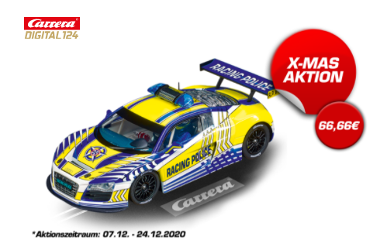
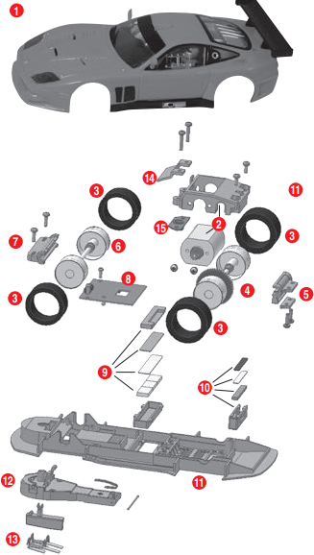
Components selection
Car model Audi R8 LMS "Carrera Racing Police"
- Dimensions: 19.05 x 8.42 x 5.16 cm
- Steering: Differential gear
- Motors: Engine Z10 18.000 rev/min
- Operation method: n/a.
- Price: 66.66*4 = 266.64 euro
- I suggest to modify their appearance, they be more formal (i.e., adding TUH, ComNets stickers)
Proposed car model
Car model exploded view

Slide 12
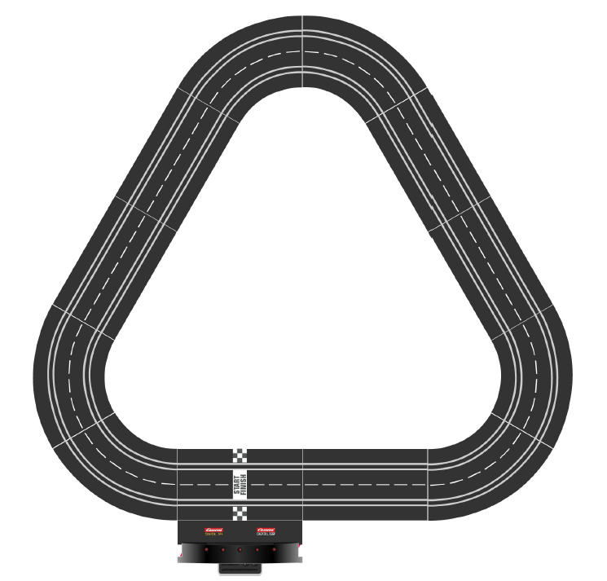
Components selection
Track:
Suggested track:
- 6 (1/60) curves.
- 6 straight (34.5 cm) strips.
Total estimated length : 4.3 ~ 3.7 meter
Total cost:47*2 + 2*47 = 188 euro “Without shopping”
# of spare parts: 3 extra straight strips
- (18V, 3Amp) Power transformer: 85 Euro
- Control unit 67 Euro
- Track Connection Clips (20) ~ 8 Euro
Total cost: 348 + 266.64 = 615 Euro
Proposed track

Slide 13
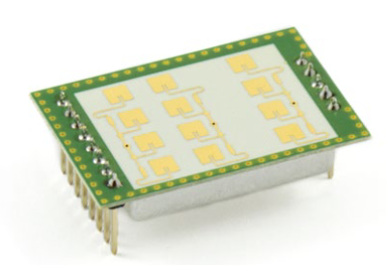
Components selection
Preceding vehicle velocity and relative distance measurements:
1. K-LD7digital radar transceiver by RFbeam Microwave GmbH
- Function: They claim, it can measure distance and speed of objects, in a specified range diameter, there are also, alternative models, I need to compare between them in order to select the most suitable module.
- Price: 66-euro, ref. Digi-Key, datasheet
- Alternative; DEMO DISTANCE2GO, by Infineon costs 220 euro.
2. Distance measurements using Ultra-sonic (HY-SRF05) sensor, velocity can be calculated using RTC values from the MCU side.
Doppler-effect radar sensor 24 GHz frequency

Slide 14
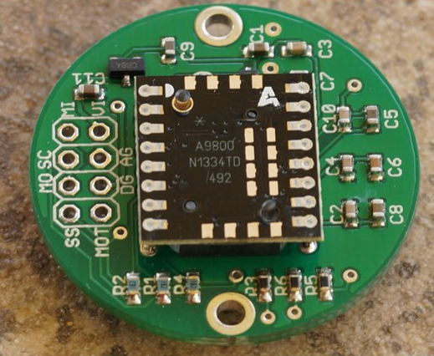
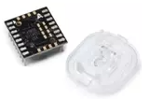
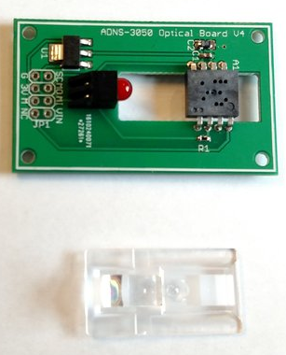
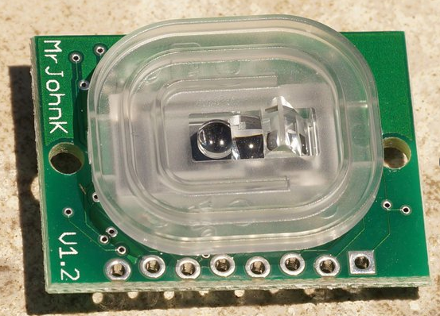
Components selection
Velocity and acceleration sensors, for vehicle’s measurements:
Velocity measurements:
Method (1): Depending on distance measurements via Laser sensor, and RTC values:
Mouse IC ADNS-9800 A9800 Laser Gaming Sensor + ADNS-6190-002 Laser Stream Gaming Round Lens “AliExpress”, 10 €.
ADNS-9800 Laser Motion Sensor (36 €) “With shipping” breakout kit.
Alternative: PMW3360 Motion Sensor (39 €) “with shipping”
Another option: ADNS-3050 Optical Sensor Board (20 €) “with shipping”
Different types of optical sensors

Slide 15
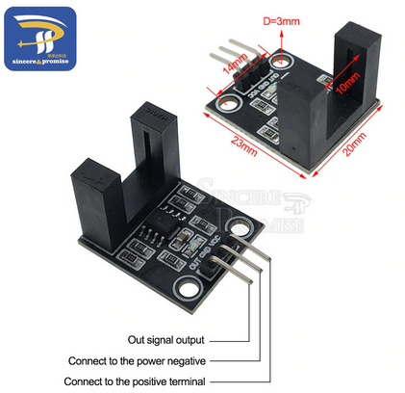
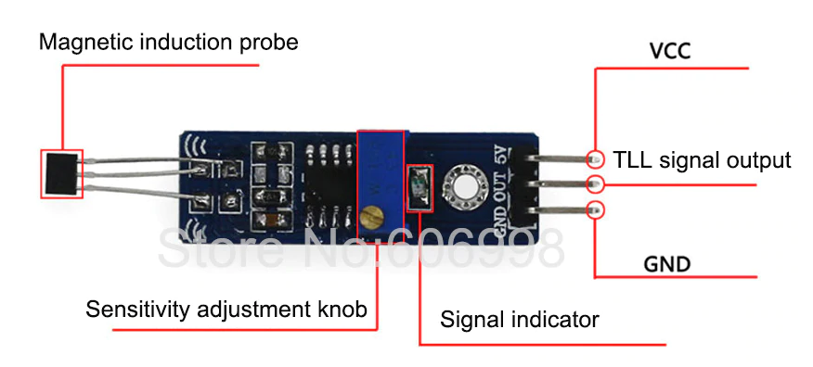
Components selection
Velocity and acceleration sensors, for vehicle’s measurements:
Method (1): Measure actual values.
2. Using Optical speed sensor:
- Price: € 0.47 + € 1.3 “for 6 pieces” shipping
3. Hall sensor (Requires additional magnet attached to the wheels):
- € 0,98 + € 3.5 “shipping for 5 pieces”
Optical shaft encoder
Hall effect shaft encoder

Slide 16
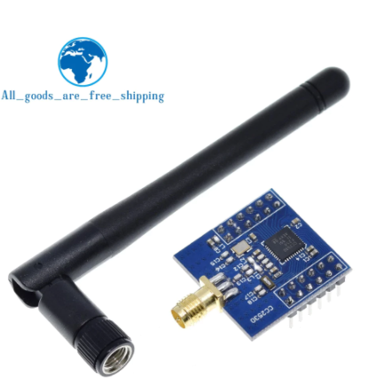
Components selection
ZigBee module “CC2530”:
-in case implementation for BLE or Soft- TDMAC Wi-Fi, was not successful, will use the previous software implementation
- Hardware by TEXAS INSTRUMENTS
- Price: 4 € +1.7 € shipping
- Do we need to measure the acceleration?
ZigBee radio module

Slide 17
Components selection
Power specs:
Component name | Input voltage (V) | Max operating current (mA)
MCU: ESP32 | 3.3 | 240
ZigBee (Communication module ONLY) | 2 V–3.6 V | 34
Radar sensor
K-LD2 | 3.2 - 5.5 | 65
K-LD7 | 3.2 - 5.5 | 160
Ultrasonic sensor | 5 | 2
Hall effect sensor | 4.5 - 24 | 4.4 - 9
Optical speed sensor | 3.5 - 5 | N/A
Optical Laser sensor (Wake up current)
ADNS-9800 | 3 .0 -5.0 | 30
PMW3360DM‐T2QU | 1.8 ‐ 2.1 | 50
ADNS-3050 | 2.8 - 3 | 50

Slide 18
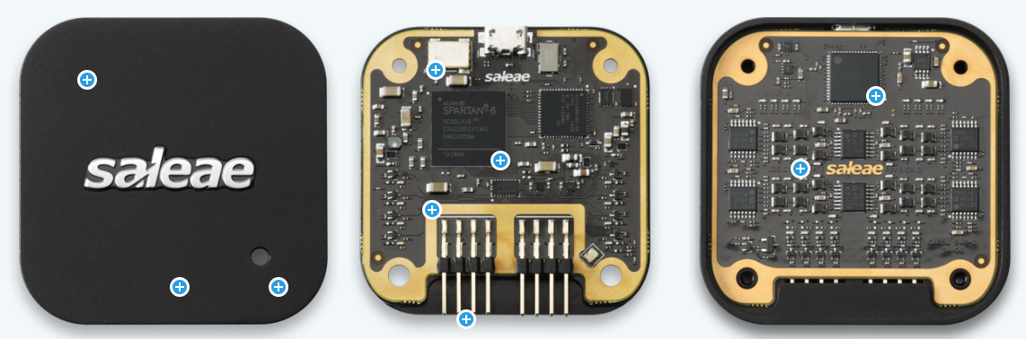
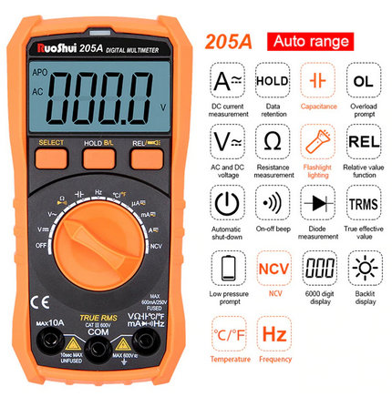
Components selection
Additional components:
- Logic Analyzer:
-> Saleae Logic 8 -> Price: 340 €
- AVO (Multi-meter):
-> Auto Range AC/DC Voltage Meter Flash Back Light Large LCD Screen Multi-metro -> Price:12.60 €
- Working tools -?
- Still not decided: Power supply, and power distribution.
Logic analyzer
Multi-meter

Slide 19
Work Plan
Literature review, challenge understanding.
Component preparation and justification.
Purchase list preparation.
Assembly.
Embedded software development.
Hardware evaluation.
Communication evaluation.

Slide 20
Timeline
Kickoff 7. Jan
Hardware evaluation 19. Feb
Components purchase 15. Jan
Embedded software development 9. Feb
Communication implementation 1st March
Communication evaluation 16. March
Re-evaluation 1st April
Documentation finalization 20 April
Proposed timeline

Slide 21
First to be done:
Project topic decision:
1. “Design, implementation, and evaluation of an experimental platform for autonomous driving platoon relying on Cooperative Adaptive Cruise Control (CACC)”
2. Design, implementation, and evaluation of an experimental platform for autonomous platooning based on CACC, an application of networked cyber-physical systems.
3. Design and Evaluation of an Autonomous Driving Platform for a Cooperative Adaptive Cruise Control Testbed
User application submission.
Property rights document submission

Slide 22
Questions

Slide 23
Thank you

